Slide 1




Introduction to MQTT Messaging in LabVIEW
UKTAG Meeting #7
François Normandin
Certified LabVIEW Architect
LabVIEW Champion
https://www.linkedin.com/in/francois-normandin
https://github.com/francois-normandin

Slide 2
Outline
Presentation
Overview of MQTT Protocol
Native LabVIEW MQTT Server and Client libraries
Demos (featuring LabVIEW and Python)

Slide 3
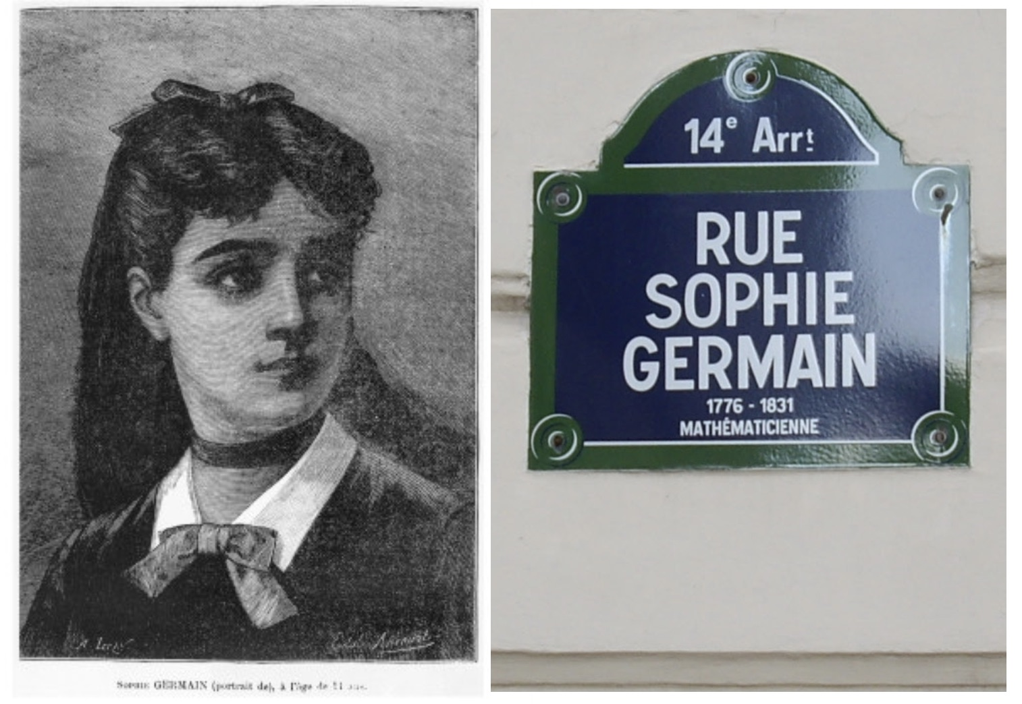
#OurGiantsAreFemale
SOPHIE GERMAIN
Late 18th, early 19th century French mathematician
Designed the first general strategy to solving Fermat’s Last Theorem (x^n + y^n = z^n)
Corresponded profusely with Carl Friedrich Gauss and others, using the pseudonym Antoine Auguste Le Blanc
Probably saved Pr. Gauss from Napoleon’s troops… and when he learned who she actually was.
Germain Prime Numbers

Slide 4


Open Source Enthusiast
24 open source VI Packages on vipm.io
35+ public repositories on github.com
(MQTT, Oauth2, OpenSerializer, Epoch-Time, Cron, UI Tools, etc.)
Board member at GCentral
Enabling the LabVIEW community to make the best version of itself.
Improving our community's capability by removing barriers to collaboration.
Maintainer of JKI’s Caraya Unit Test framework
Maintainer of JKI’s State Machine Objects framework

Slide 5

MQTT is a lightweight publish-subscribe protocol.
Important features:
Open standard
Suited to work on any ordered, lossless, bidirectional connections
TCP, WebSocket, Network Stream, Serial, …
Client code is small and uncomplicated
Ideal for low-bandwidth, low-energy devices
Tolerant to high-latency connections
Quality-of-Service delivery

Slide 6
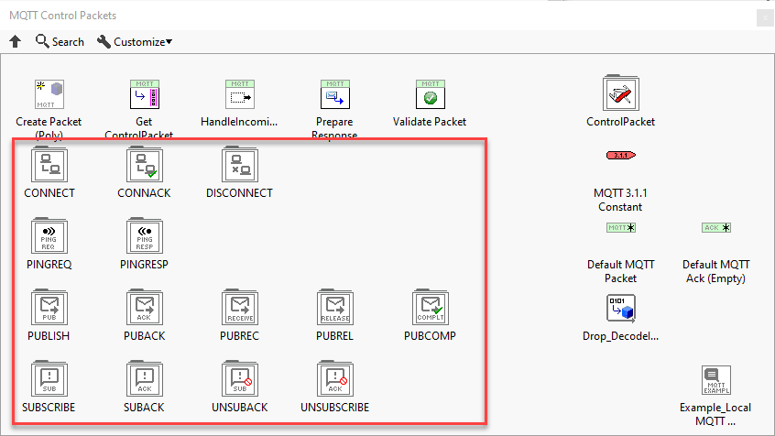
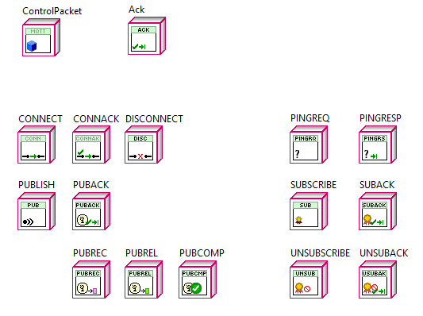
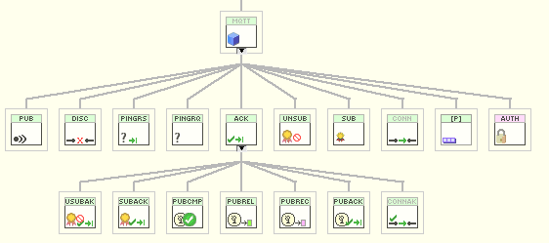
MQTT Implementation
Specifications (OASIS 3.1.1 and 5.0)
Control Packets

Slide 7
Quality of Service
Quality of Service (QoS) defines the lifetime and ownership of exchanged messages.
QoS is based on the receiver’s preferences.
QoS = 0 (At most once delivery)
Fire and Forget
QoS = 1 (At least once delivery)
Acknowledges the message was received. Ack message could be lost
QoS = 2 (Exactly once delivery)
Acknowledges message was received and hold on to original message until sender acknowledges the acknowledgement.

Slide 8
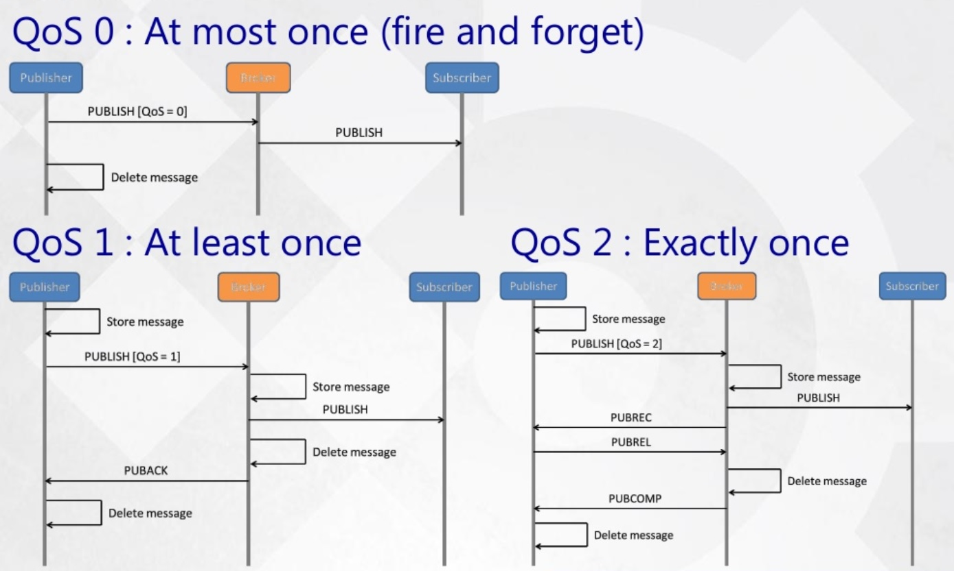
QoS Example
Setup: Broker + Two Clients (Publisher’s perspective with QoS = 0 Subscriber)
Credit: https://devopedia.org/mqtt

Slide 9
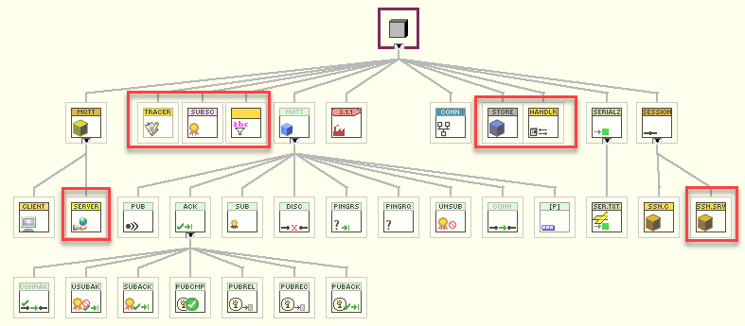
LV-MQTT Broker and Client
Control Packets
Base, Client, Server
Connection Handler
Session
Connection
Subscription
New version 3.2.0 of MQTT Broker has been published earlier this week.
Available on VIPM Community

Slide 10
Test-Driven approach
The OASIS MQTT 3.1.1 Specification has 141 normative requirements
LV-MQTT’s Unit Tests are covering 68 of these requirements, but implementation currently really covers:
100% of Client requirements
~90% of Server requirements

Slide 11
Closing a requirement
Any “requirement” issue stays opened in GitHub’s project page until all conditions are met:
The feature has been implemented in code
Unit tests are designed to confirm the functionality exists
If possible, units tests are designed to confirm variations are accounted for. Below, there would be a minimum of 8 individual tests to run.

Slide 12
MQTT Server Compliance
List of features not yet implemented in LV-MQTT Broker project:
RETAIN FLAG
WILL MESSAGE
DUPLICATE
Advanced topic filters (ex: test/+/state)
ClientID Uniqueness verification
KeepAlive
These features have been considered at the initial design phase so they will be easy to incorporate and should not require any major refactors… but instead of aiming for 100% coverage, this project aims at being reliable and well architected for incremental improvement.

Slide 13
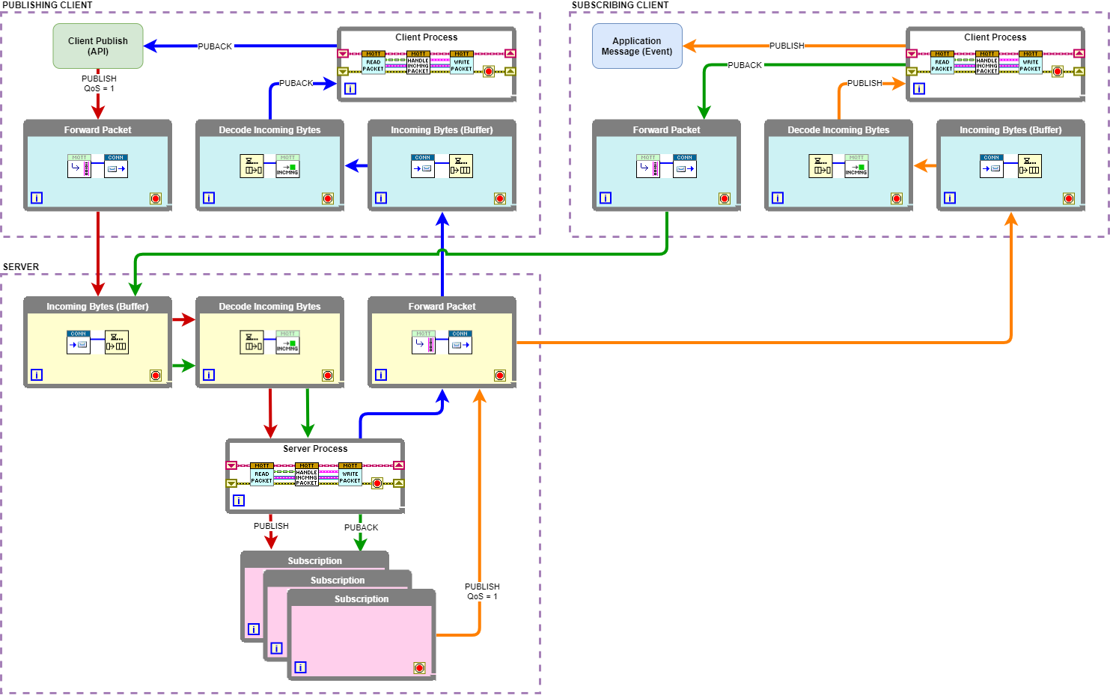
The broker was the goal…
Decoupled processes to break down the functionality and make it modular.
Building a client was an afterthought and a mean to test the broker.
1- Incoming Connection
2- Reconstruct packet
3- Handle Request
4- Outgoing packet
Source: G Open Source Project MQTT Broker’s Wiki
https://github.com/LabVIEW-Open-Source/LV-MQTT-Broker/wiki/Publish-message-with-QoS-=-1

Slide 14
Client for free
Client and Server are completely symmetrical.
They are built on the same communication layer (identical send & receive).
They process acknowledgements in a mirror fashion.
The client has a single session while the server maintains multiple sessions through a connection handler
Source: G Open Source Project MQTT Broker’s Wiki
https://github.com/LabVIEW-Open-Source/LV-MQTT-Broker/wiki/Publish-message-with-QoS-=-1

Slide 15
Abstraction layers
Strategy Pattern
Connection (show example TCP, Local Queue, WS, …)
Tracing / Logging
Visitor Pattern
Serializer (LabVIEW Flatten String, Base64, JSON, …)
Command Pattern
Control Packet (for extending the communication protocol)
Why these levels of abstraction?
Not forced to use features you don’t need (lightweight, customizable)
Extendable framework
community implementations encouraged
Private IP is easy to integrate without forking whole project

Slide 16
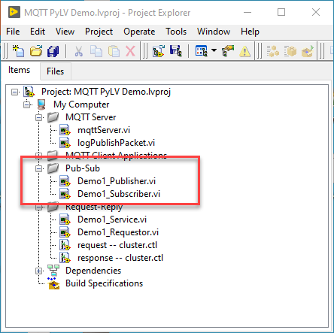
Messaging Patterns
Publish-Subscribe

Slide 17
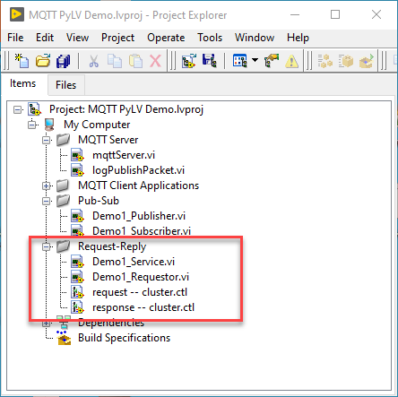
Messaging Patterns
Request - Reply

Slide 18
Demo
https://github.com/francois-normandin/mqtt-lv-py-demo

Slide 19
THANK YOU ALL
Question? Suggestions? Want to know more?
https://github.com/LabVIEW-Open-Source/LV-MQTT-Broker
Or look for these short videos on Youtube!
MQTT Broker in LabVIEW: https://youtu.be/Y-jrwyfD9DU
TLS Secured MQTT: https://youtu.be/2-OJ-U6eTmE
Open Serializer: https://youtu.be/Y_GyZVHIORI
François Normandin
Certified LabVIEW Architect
LabVIEW Champion
https://www.linkedin.com/in/francois-normandin
https://github.com/francois-normandin

